Slide 1
Prediction Error based Interaction Measure for Control Configuration Selection in Linear and Nonlinear Systems
Miguel Castaño Arranz Luleå University of Technology
Wolfgang Birk Luleå University of Technology

Slide 2
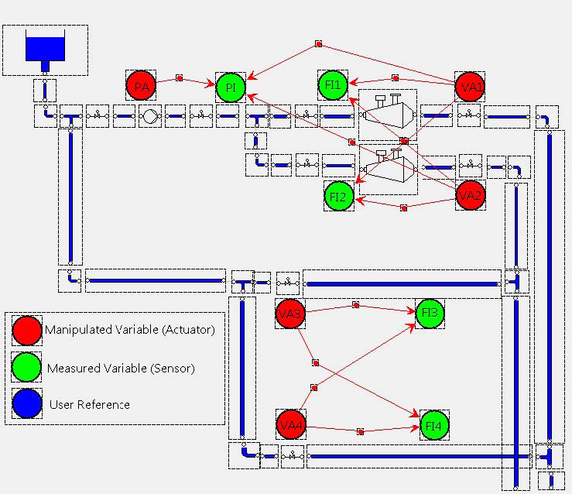
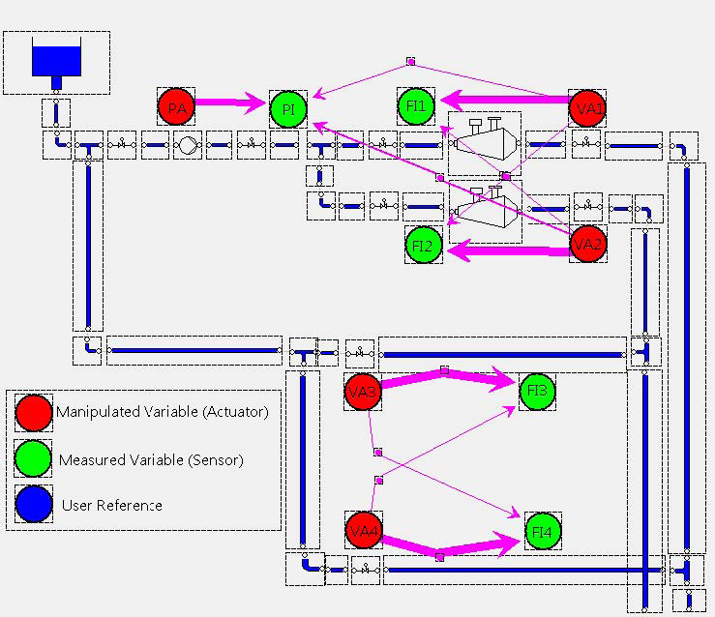
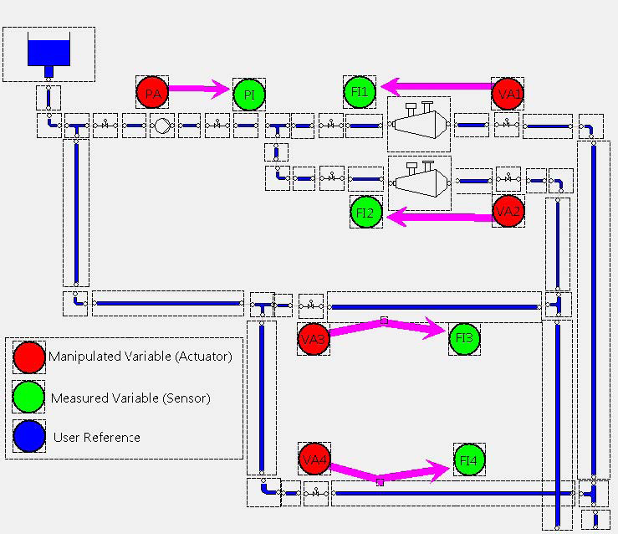
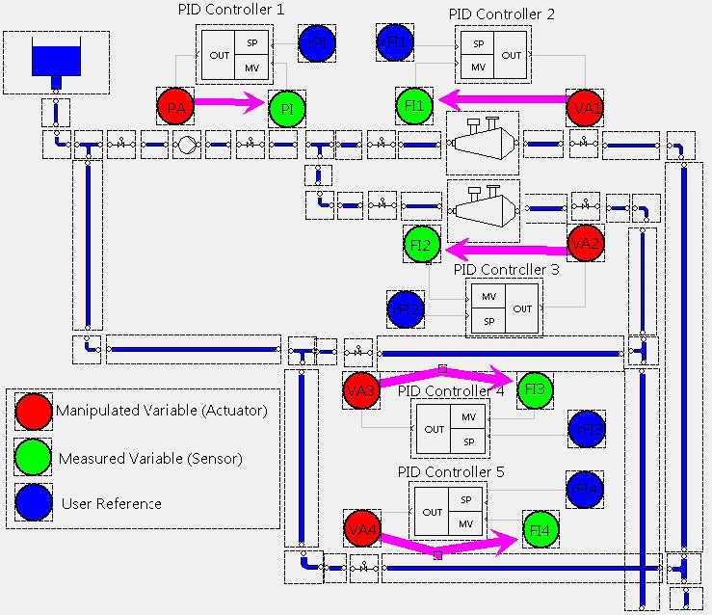
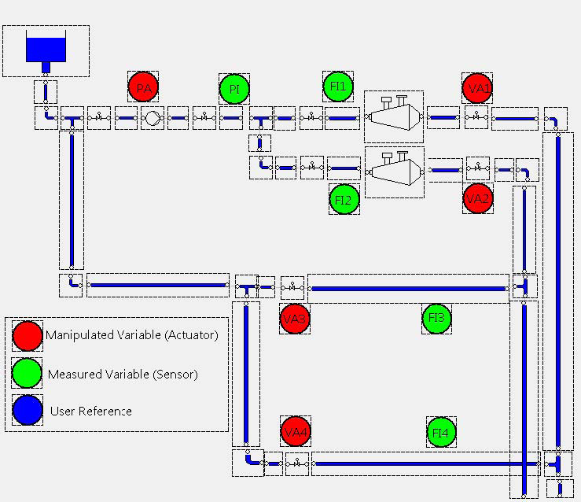






A procedure for control design of complex processes
Process data
Subset of sensors and actuators
(IO Selection)
Model
Control Configuration
Performance specification
Controller parameters
Implemented controller
Example: Stock Preparation Plant at SCA Obbola AB, Sweden

Slide 3
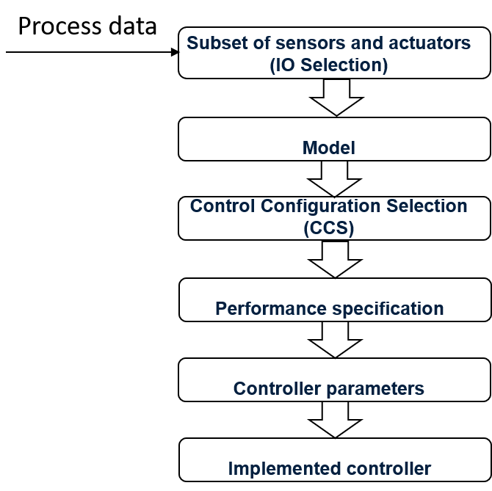
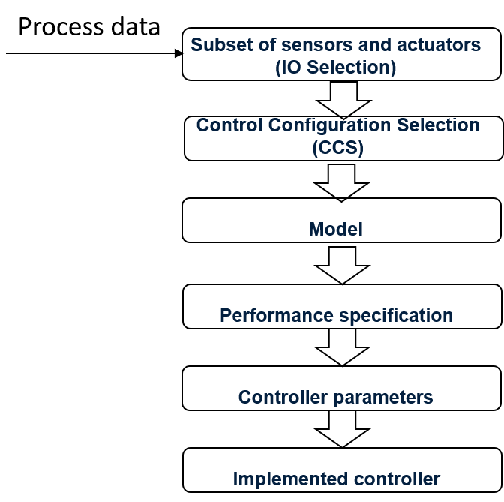
Vision: Shifting the paradigm using data-driven CCS
Traditional Approach
Vision
CCS requires the availability linear process models for the full plant.
Data-driven CCS derives structural properties of the system prior to modeling.
Later modeling efforts need only to be placed on the structurally relevant components, as opposed to modeling the full plant.
Challenges for shifting the paradigm:
Create CCS methods generally applicable to nonlinear systems
Extend the nonlinear methods to be applicable on process data
Goal of this paper
Future research

Slide 4
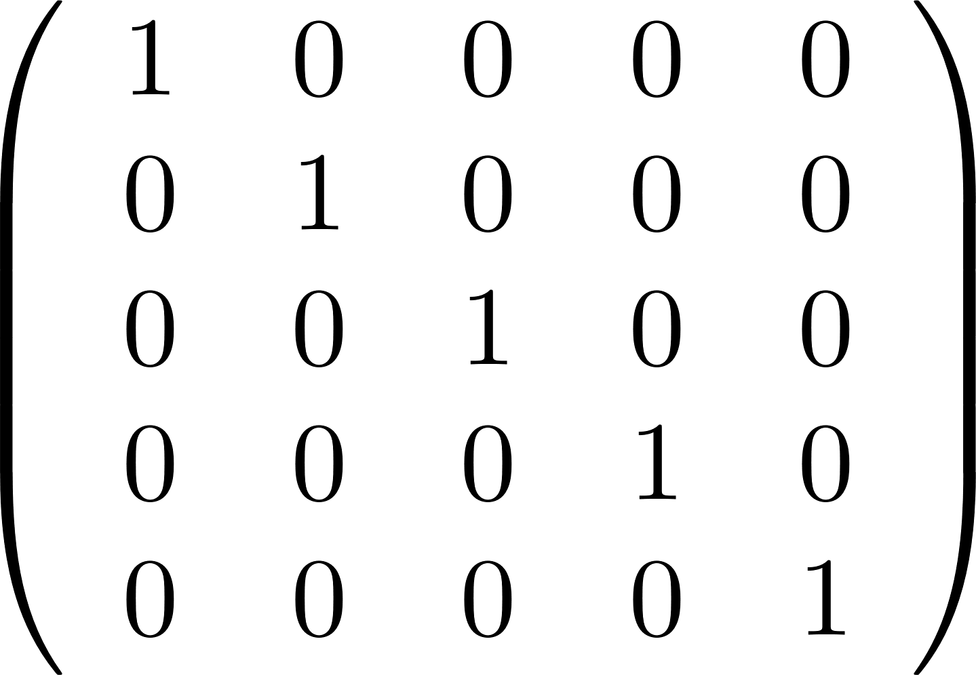
Control Configuration Selection (CCS)
The control configuration of a controller for a multivariable process is traditionally represented as a binary connection matrix between measurements and actuators which has at least one element different from zero in each row and each column.
Designing the control configuration is choosing the set of measurements which are used for the calculation of the control action on each actuator.
This can be done by quantifying the significance of the input-output interconnections and assigning a value of 1 to the most important ones.
CCS can be understood as a reduction of the model structure.
The H₂-norm can be used for this quantification due to its energy transfer interpretations (next slide).
Decentralized Controller
Plant
Control Configuration:
r
e
u
y
-
+

Slide 5
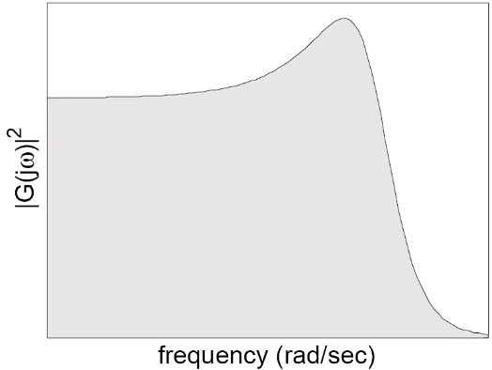
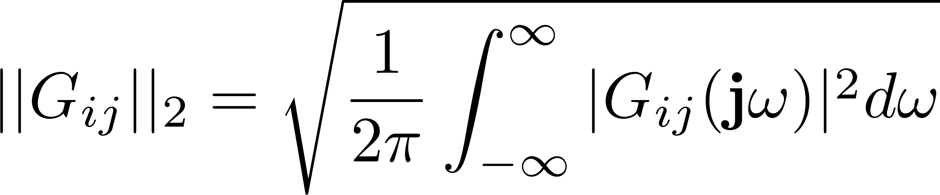
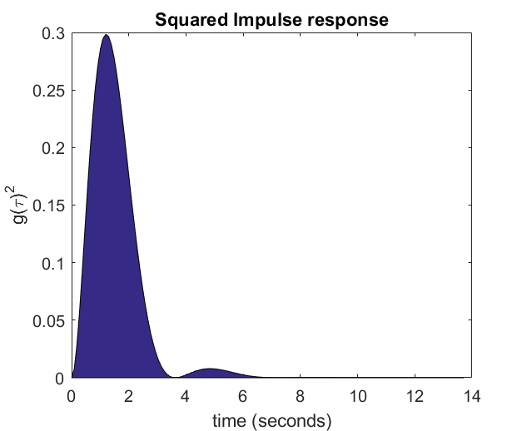
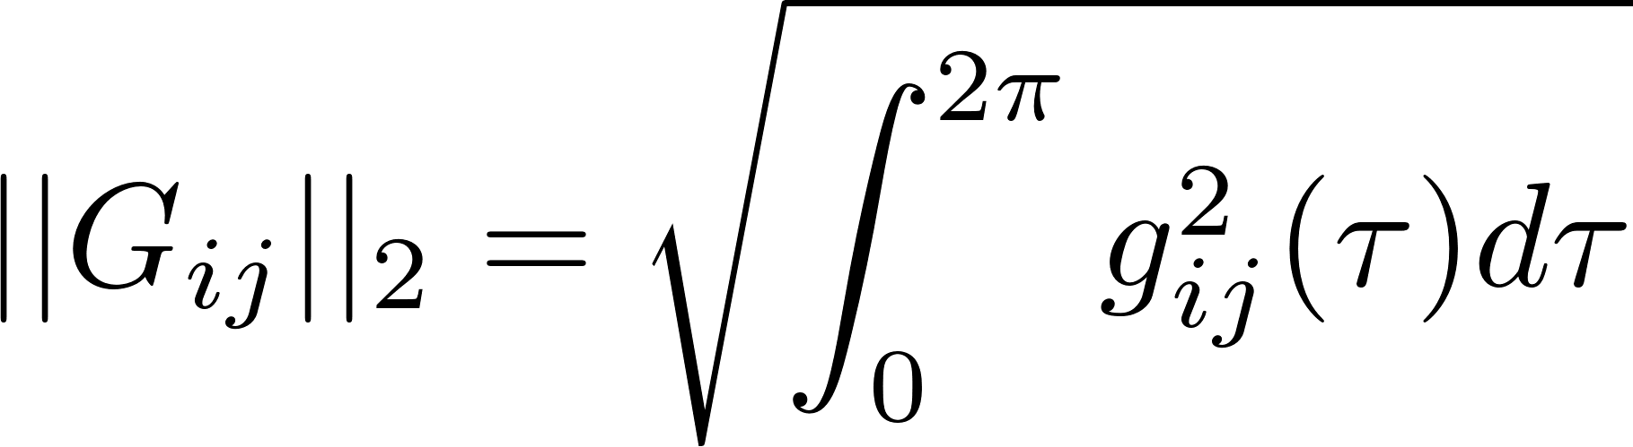
Why using the H₂-norm to quantify the significance of IO channels
The squared H₂-norm is the output energy when the input is exited with an input signal with unitary flat power spectral density (psd). It is a gain conversion between input and output energies for flat psd excitation.
The squared H₂-norm is also the energy of the impulse response.
Area under squared magnitude
Area under squared impulse response
Additionally, the H₂-norm can be calculated from the gramians and be interpreted in terms of output controllability.

Slide 6
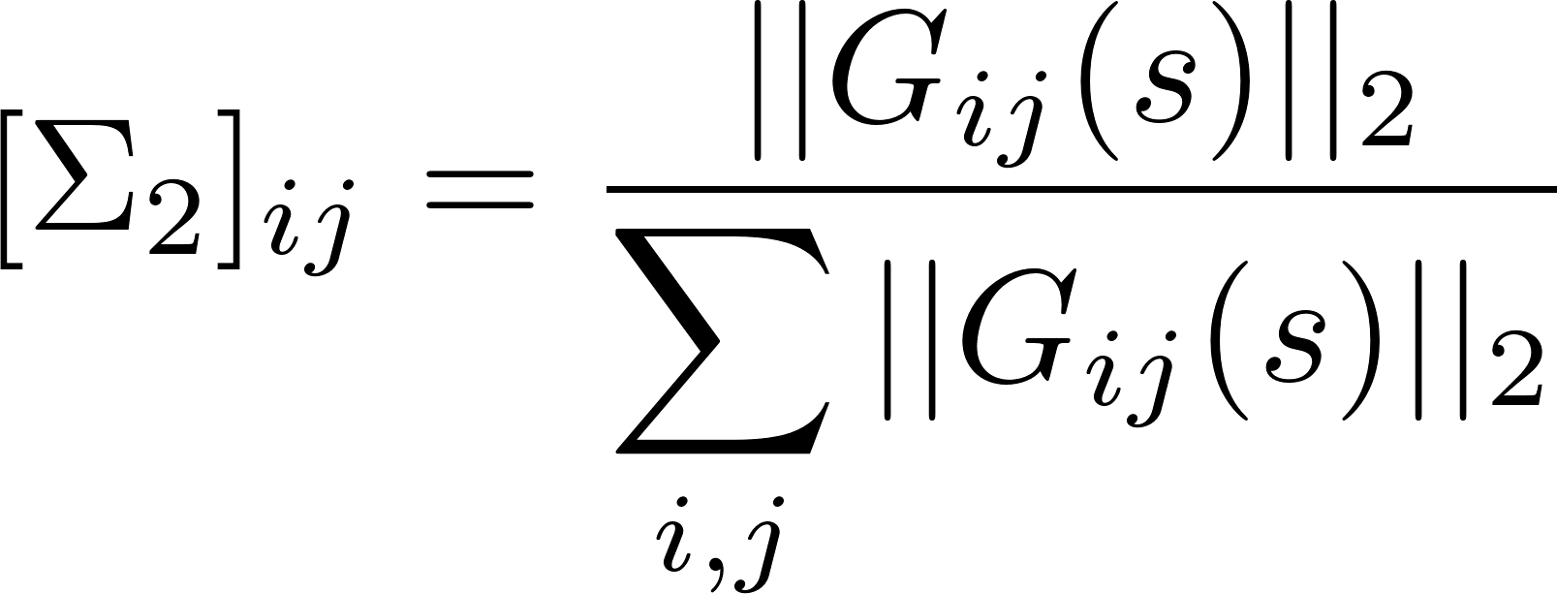
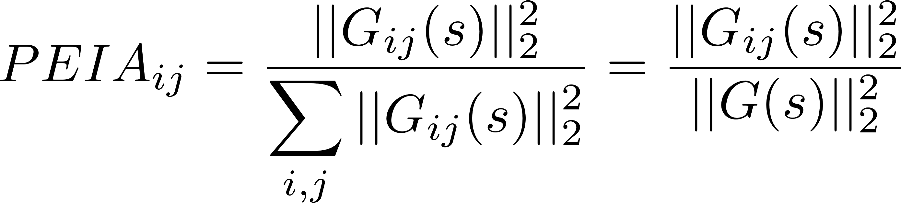
Linear Prediction Error Index Array (PEIA)
Σ₂ was originally defined by Birk & Medvedev (2003) and uses the H₂-norm to quantify the significance of the input-output channels:
Due to more direct energy interpretations, the relation to prediction error, and the decomposition property (see paper), we introduce the following redefinition and name it PEIA due
The decomposition property means that the sum of the squared H₂-norms for each input-output channel equals the H₂-norm of the complete system.
Birk, W. and Medvedev, A., 2003, September. A note on gramian-based interaction measures. In Proc. of the European Control Conference.
Castaño, M. and Birk, W., 2012. New methods for interaction analysis of complex processes using weighted graphs. Journal of Process Control, 22(1), pp.280-295.

Slide 7
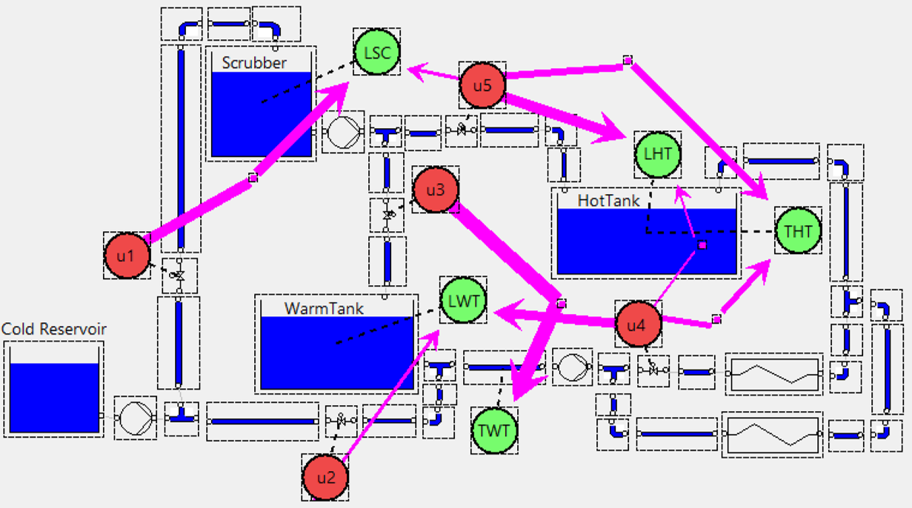
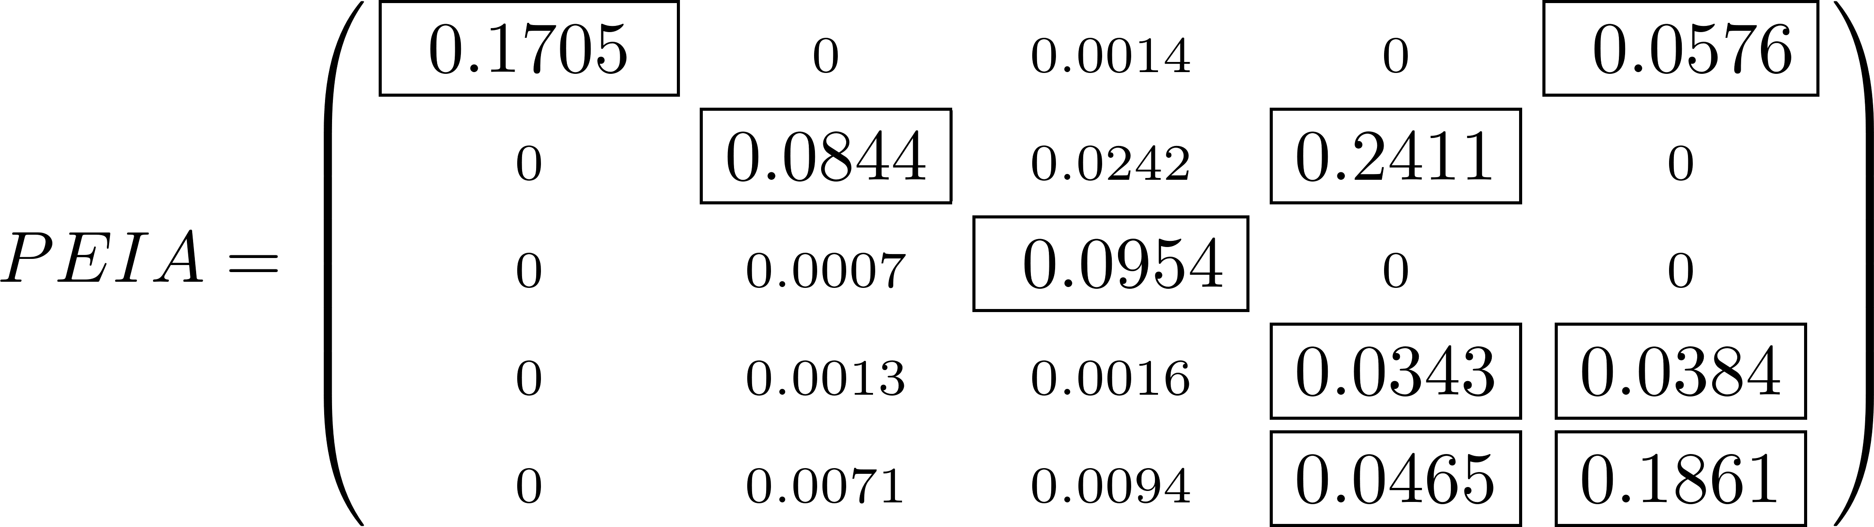
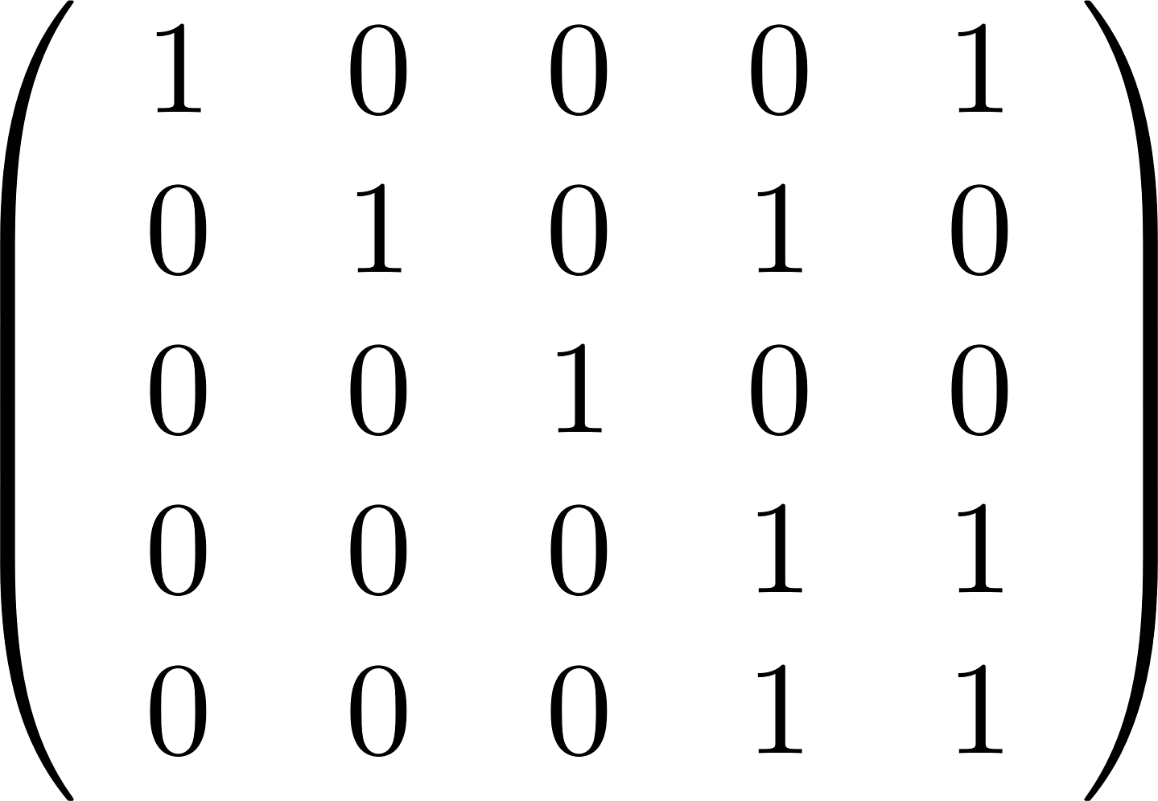
Exampe of using PEIA on a Secondary Heating System
u1 u2 u3 u4 u5
LSC
LWT
TWT
THT
LHT
Control Configuration:

Slide 8
Extension of the Prediction Error Index Array (PEIA) to nonlinear systems
Representation of a nonlinear system using Volterra series expansion:
truncation
Volterra series:
can represent most of the nonlinearities except those with time-varying propertes (e.g. hysteresis).
are not recommended in practicce for very strong nonlinearities such as saturations due to the need of many terms in the expansion.
can be used to represent precisely Wiener and Hamerstein systems (see examples in paper).
can be used to approximate general nonlinear system representations like Modulator-Demodulator (MoDem) of a truncated Volterra Series often truncated at order 3 (see equation above).
The linear Prediction Error Index Array has been defined to be used on Volterra series
Preserving the energy interpretatons, including the one in relation with the prediction error.
Derivations for the calculations of series up to order 3 are included in the paper.
Derivations are complex but with but calculations don’t have a high computational load.
The result depends on the level of excitation of the input signals.

Slide 9
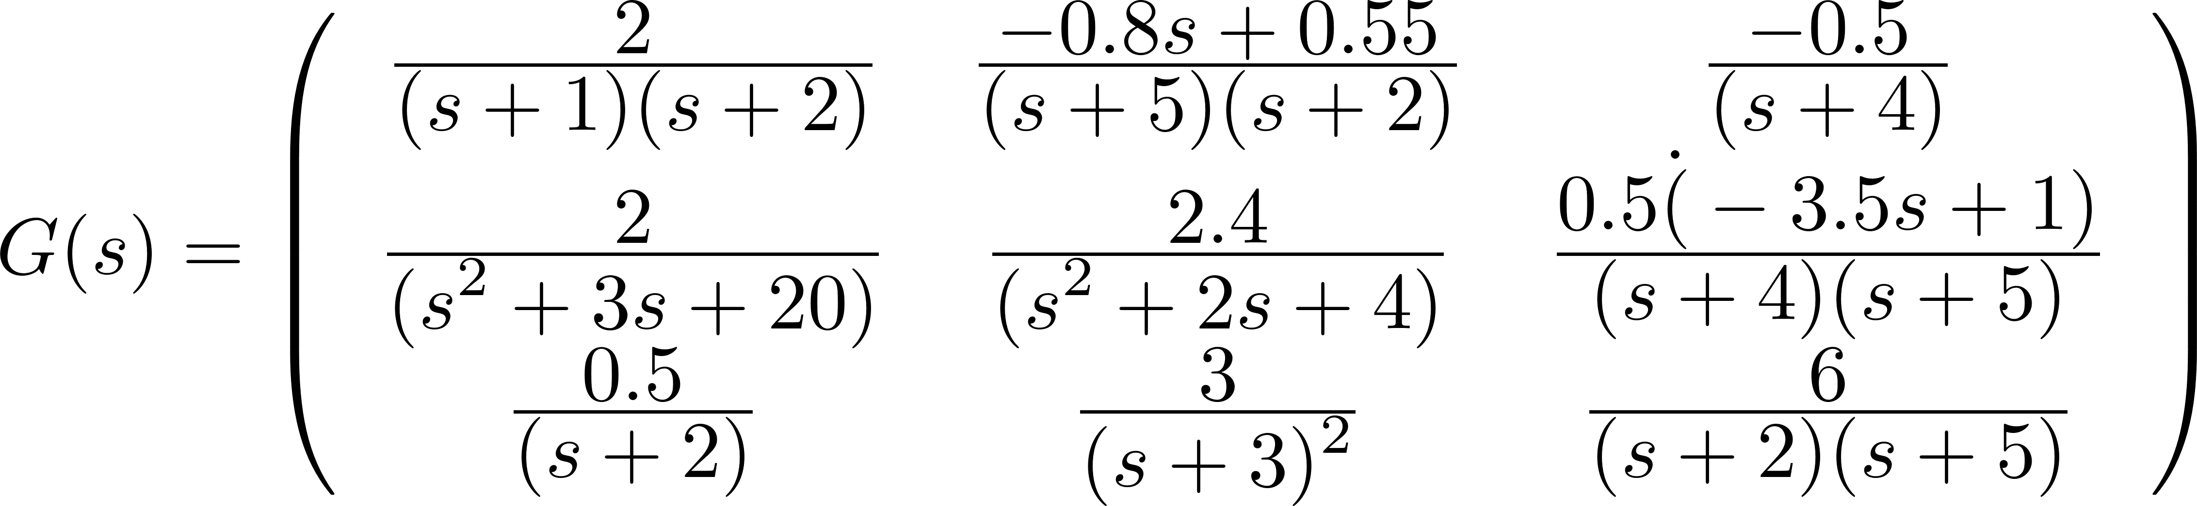
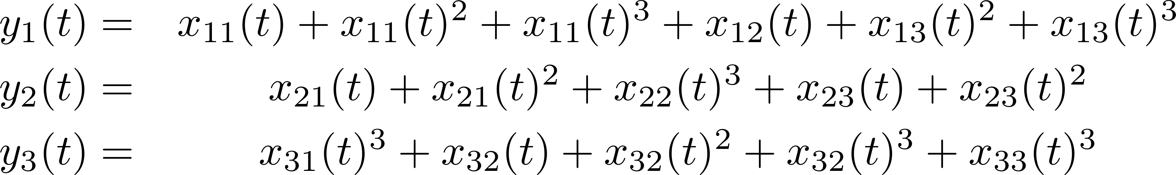
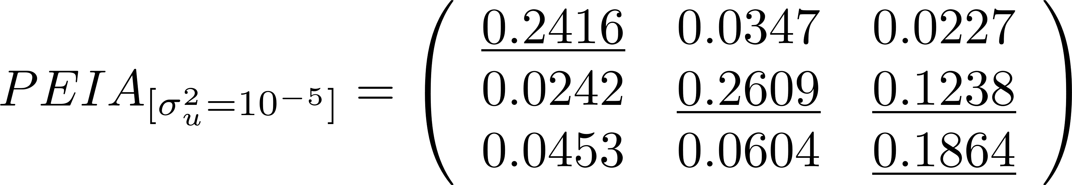
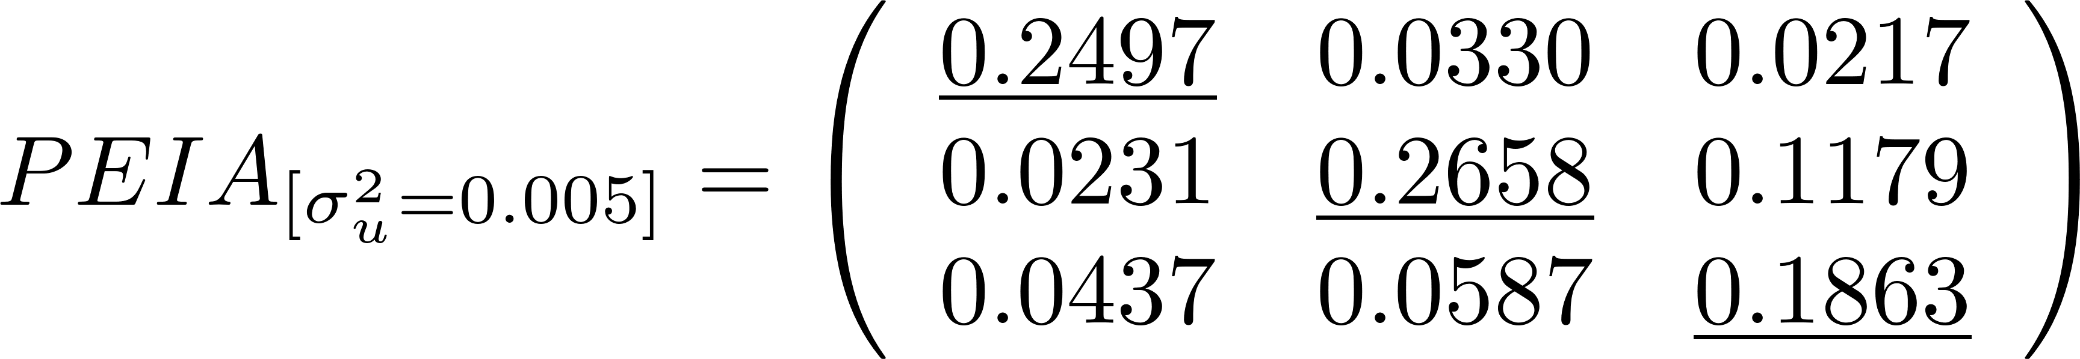
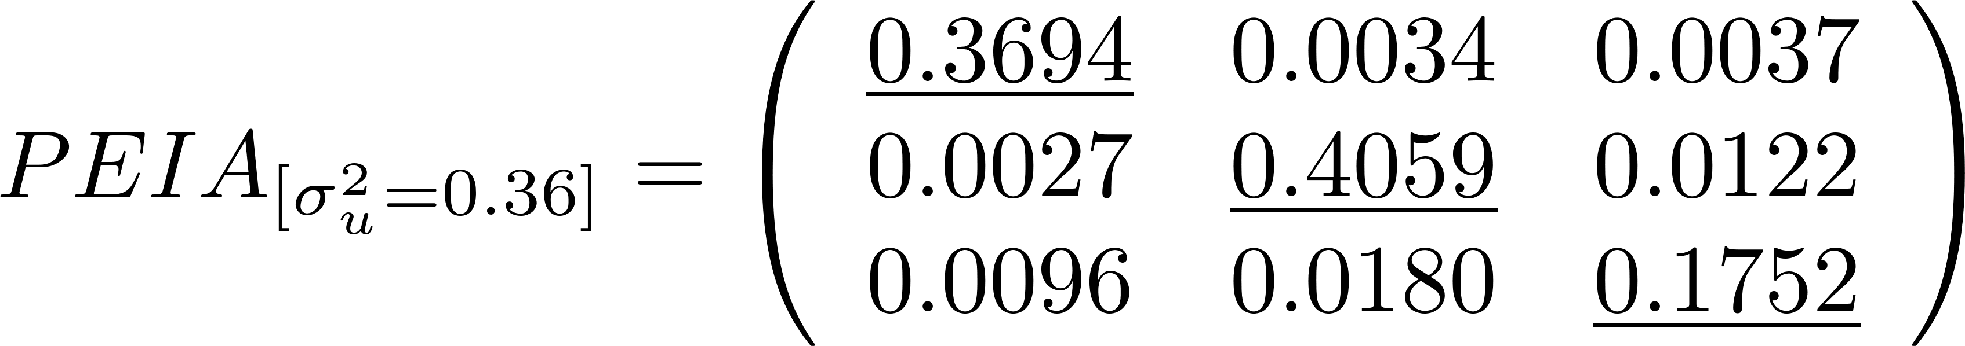
Numerical Example with the nonlinear PEIA
System definition:
u(t)
x(t)
Output Nonlinearity
y(t)
G(s)
Output nonlinearity
As the variance of the excitation increases, the diagonal dominance increases
Small Gain Approximation: The PEIA for very low excitation level is the same as the PEIA for the linear approximation G(s)
The control configuration might change with the excitation level and even be simplified. In this example, the nonlinear contributions in the diagonal increase in importance with the level of the excitation signal.

Slide 10
Concluding remarks on the Prediction Error Index Array (PEIA)
A method for Control Configuration Selection for nonlinear system using Volterra series has been introduced and named PEIA.
Volterra series are a very general representation often used to generalize theory for nonlinear systems.
PEIA has energy interpretations in relation to the prediction error commited when choosing a structuraly reduced process model during Control Configuration Selection.
As oppossed to linear systems, the indications depend on the excitation level.
It may happen that as the excitation level increases, the change in the nonlinear contributions lead to a larger simplification of the structural representation of the system.
Future Work: Recent results in the estimation of Volterra series will allow the appliation of these methods directly on process data.

Slide 11
Questions?

Slide 12
Support slides

Slide 13
Criteria for selecting the examples
Example 2 illustrates how input polynomial nonlinearities (Hammerstein) are perfectly represented in this approach.
Example 3 illustrates how output polynomial nonlinearities (Wiener) are perfectly represented in this approach.
Example 3 illustrates that the small-variance nonlinear PEIA converges to the linear PEIA for the linearization (proof in section 4).
Example 3 illustrates that output nonlinearities which make the internal states interact can also be represented.

Slide 14
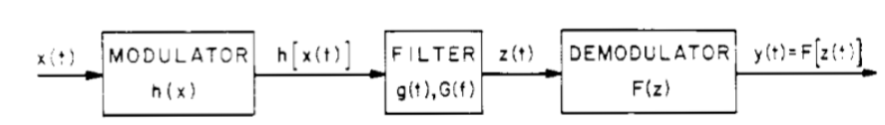
Relevance for future work
According to Bedrosian and Rice, Volterra series allow us to attack the general modulator-demodulator nonlinear systems saving from a morass of algebra. It is often possible to neglect kernels of order higher than 3.
Bedrosian and Rice introduced the leading terms of the output of a Volterra series for a number of different input signals (e.g. sine waves). So we are not restricted to gaussian noise and we can potentially select a frequency band by composing sine waves.
This includes Hammerstein-Wiener systems
E. Bedrosian and S. O. Rice, "The output properties of Volterra systems (nonlinear systems with memory) driven by harmonic and Gaussian inputs," in Proceedings of the IEEE, 1971.

Slide 15
Envisioned applications in chemical industry
pH neutralization (sub)process has a large output nonlinearity and can be represented as a Wiener system (see Gomez and Bayens).
Distillation columns are widely studied processes for Control Configuration selection and can be modeled as Hammerstein and Wiener systems (see Gomez and Bayens).
Fermentation biorreactores typically used in chemical processes can be represented with Hammerstein-Wiener models (see Luou and Song).
Juan C. Gómez, Enrique Baeyens, Identification of block-oriented nonlinear systems using orthonormal bases, Journal of Process Control 2004.
Xiao-Suo Luo, Yong-Duan Song, Data-driven predictive control of Hammerstein–Wiener systems based on subspace identification, Information Sciences 2018.

Slide 16
Control Configuration Selection
Problem definition:
Determine a control configuration of least complexity that yields a sufficient closed-loop performance for the complete multivariable system, without designing the controller parameters.
The control configuration complexity is quantified as the number of non-zero elements in the transfer function of the controller.
Why not designing a full MIMO controller?
Full multivariable controllers have the largest achievable performance. However:
Decentralized controllers are simpler to design, implement and maintain.
Decentralized controllers are more robust to plant failures.
There is a trade-off between simplicity and robustness Vs achievable performance.

Slide 17
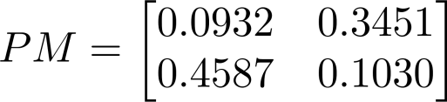
PEIA as a gramian-based Interaction Measures
The sum of all the elements in a gramian-based Interaction Measure adds up to 1.
The sum of the considered elements quantifies the considered process dynamics.
An off-diagonal controller for the PM below will consider 0.80 (80%) of the process dynamics.
Satisfactory performance is usually obtained with configurations with a contribution larger than 0.7
The gramian-based IMs require adequate scaling of the inputs and outputs.
The gramian-based IMs consider process dynamics.

